Slide 1
Database & Storage Security
Professor Dr. Mohammad Abu Yousuf
yousuf@juniv.edu

Slide 2
Geospatial Database Security

Slide 3
Introduction
Introduction to Geospatial Database
Geospatial data models
Vector data
Raster data
Geospatial Access Control Models
Geospatial Data Authorization Model
Geospatial Role Based Access Control
Location based Access Control
Geospatial Web based Access Control
Notes:
What is the project about?
Define the goal of this project
Is it similar to projects in the past or is it a new effort?
Define the scope of this project
Is it an independent project or is it related to other projects?
* Note that this slide is not necessary for weekly status meetings

Slide 4
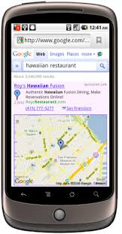
Real life examples
A passenger bus /car fallen in accident may need to transmit message to nearby hospital for medical help.
The hospital may need to identify his location to bring him to the hospital
Notes:
* If any of these issues caused a schedule delay or need to be discussed further, include details in next slide.

Slide 5
Real life examples
A rental microbus has come to Dhaka from Dinajpur to carry its passengers.
On return the driver may search for passengers willing to travel from Dhaka to Dinajpur.
Notes:
* If any of these issues caused a schedule delay or need to be discussed further, include details in next slide.

Slide 6
Real life examples
A shop owner wants to attract its potential customers who are travelling/residing inside Dhaka city.
Big discount for a limited period.
Notes:
* If any of these issues caused a schedule delay or need to be discussed further, include details in next slide.

Slide 7
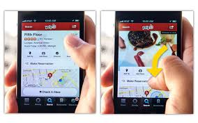
Real life examples
A family travelling in a car searches a restaurant for dinner.
Notes:
* If any of these issues caused a schedule delay or need to be discussed further, include details in next slide.

Slide 8
Introduction to Geospatial Database
Geospatial data
Spatial data, also known as geospatial data, is information about a physical object that can be represented by numerical values in a geographic coordinate system.
Generally speaking, spatial data represents the location, size and shape of an object on planet Earth such as a building, lake, mountain or township.

Slide 9
Introduction to Geospatial Database
Geospatial data
There are many resources that has location based information (represented by longitude and latitude) which are useful for us.
Availability of these resources to the right person through mobile Internet has become a new type of service that is growing day by day.
Map, aerial & satellite images are associated with location information represented by longitude and latitude:
River, school, park, road
rainfall, vegetation index, population, environmental pollution index etc.
Notes:
* If any of these issues caused a schedule delay or need to be discussed further, include details in next slide.

Slide 10
Introduction to Geospatial Database
Geospatial data
Geospatial data can be collected, analyzed, manipulated, and integrated and visualized with the help of various GIS software and Internet Map Server.
Geospatial data clearinghouse: It captures, creates, processes and disseminates spatial information with the help of various software to provide an information service.
Notes:
* If any of these issues caused a schedule delay or need to be discussed further, include details in next slide.

Slide 11
Introduction to Geospatial Database
GIS or other specialized software applications can be used to access, visualize, manipulate and analyze geospatial data.
Microsoft introduced two spatial data types with SQL Server 2008:
geometry and
geography.

Slide 12
Introduction to Geospatial Database
Geometry types are represented as points on a planar, or flat-earth, surface. The geometry type represents data in a Euclidean (flat) coordinate system. An example would be (5,2) where the first number represents that point's position on the horizontal (x) axis and the second number represents the point's position on the vertical (y) axis.
Geography spatial data types, on the other hand, are represented as latitudinal and longitudinal degrees, as on Earth or other earth-like surfaces. The geography type represents data in a round-earth coordinate system.

Slide 13
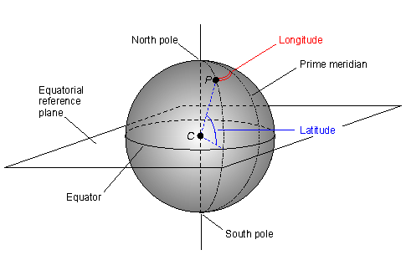
Latitude and longitude are angles that uniquely define points on a sphere.

Slide 14
Introduction to Geospatial Database
Evolution of location based information products:
The proliferation of the Internet
The proliferation of mobile network
Advancement of smartphone (high capacity processor)
Development of various GIS, GPS and other Applications that work in an integrated way to provide the service.
GIS(ArcView, ArcInfo etc)
GPS
Google Earth
Google Map
Notes:
* If any of these issues caused a schedule delay or need to be discussed further, include details in next slide.

Slide 15
Introduction to Geospatial Database
Advantage:
Citizen service (location based)
Decision making:
business facilities and site selection,
demographic analyses,
route selection, zoning,
planning, conservation, natural resource extraction,
natural and man-made damage assessment, and
national security.
Notes:
* If any of these issues caused a schedule delay or need to be discussed further, include details in next slide.

Slide 16
Introduction to Geospatial Database
Disadvantages:
Serious threats to security and privacy:
water distribution, telecommunication, bridges, tunnels, and nuclear plants,
These may cause a large scale socio-economic impact in case of failure.
Positional information of a person may lead to privacy threat
Sensitive activities of a certain location may need to be secrete.
Notes:
* If any of these issues caused a schedule delay or need to be discussed further, include details in next slide.

Slide 17
Geospatial Web Service (GWS)
Geospatial web services (GWS) help users find, access, and sometimes manipulate data of interest on the web dynamically from a distributed network.
GWS are designed to collect data once and update or edit it in real time.
Notes:
* If any of these issues caused a schedule delay or need to be discussed further, include details in next slide.

Slide 18
Geospatial Web technology
easily shares and integrates the geospatial data and applications on demand.
allows to easily create geospatial “mash-ups” that are light-weight applications that help in integrating diverse location based information.
The geospatial Web Services can be invoked using a set of XML-based standard programs and can be embedded into applications integrating many other kinds of data.
Sharing of these Web services should be done in such a way that it preserves the security and privacy specifications of their respective
Notes:
* If any of these issues caused a schedule delay or need to be discussed further, include details in next slide.

Slide 19
Introduction to Geospatial Database
How to fight with the challenge:
Policy related to Security and Privacy of both subjects and objects.
These policies for secure sharing should be properly managed by another policy so that the right policy can be efficiently located and policy inferences can be easily performed.
Notes:
* If any of these issues caused a schedule delay or need to be discussed further, include details in next slide.

Slide 20
Access Control for Geospatial Database
Access control models typically consider the characteristics of the geospatial data (Object) and the location of the user (Subject).
This is because, the security and privacy policies are often based on the Object’s contents and the Subject’s location.
Notes:
* If any of these issues caused a schedule delay or need to be discussed further, include details in next slide.

Slide 21
Access Control for Geospatial Database
Access control for this data is based on
its geospatial location,
its content and context,
the credentials and characteristics of the users requesting access
the time at which the data is captured and requested
Notes:
* If any of these issues caused a schedule delay or need to be discussed further, include details in next slide.

Slide 22
Geospatial Data Models
A data model in geographic information systems is a mathematical construct for representing geographic objects or surfaces as data.
Vector and raster data are the two primary data types used in GIS. Both vector and raster data have spatial referencing systems. These are latitudes and longitudes that pinpoint positions on Earth.
For example, the vector data model represents geography as collections of points, lines, and polygons;
the raster data model represent geography as cell matrices that store numeric values;

Slide 23
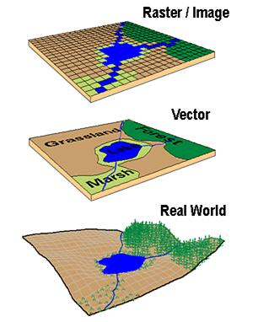
Geospatial Data Models

Slide 24
Geospatial Data Models
Vector data & Raster data
Vector
Raster
Point
Line
Zone of cells
Polygon
Notes:
Duplicate this slide as necessary if there is more than one issue.
This and related slides can be moved to the appendix or hidden if necessary.

Slide 25
Geospatial Data Models
Vector Spatial Data Types
Vector data is not made up of a grid of pixels. Instead, vector graphics are comprised of vertices and paths.
The three basic symbol types for vector data are points, lines and polygons (areas).
Raster Spatial Data Types
Raster data is made up of pixels (also referred to as grid cells). They are usually regularly-spaced and square but they don’t have to be. Rasters often look pixelated because each pixel is associated with a value or class.
For example:
Each pixel value in a digital photograph is associated with a red, green and blue value.

Slide 26
Vector data Model
Represents two components:
Spatial Attributes:
Indicates the geometric shape
points, lines and polygons
Points are represented as pairs of latitude and longitude coordinates, lines as strings of coordinate pairs and polygons as lines that form closed loops.
Records data about location, topology and geometry of geospatial data.
Water body, zoning area, forest area, all school etc.
Non-spatial Attributes (Thematic attribute):
Annual rainfall, vegetation type, zoning type, land use, census tracts etc.
Notes:
Duplicate this slide as necessary if there is more than one issue.
This and related slides can be moved to the appendix or hidden if necessary.

Slide 27

Vector data Model
Thematic layer:
A thematic layer is a collection of geometries having same attribute sets.
One theme/layer indicates the schools on the map.
Another layer indicates water bodies in a map.
Notes:
Duplicate this slide as necessary if there is more than one issue.
This and related slides can be moved to the appendix or hidden if necessary.

Slide 28
Raster data model
Spatial data (satellite images, elevation maps, digitized maps etc.) is represented as a grid of columns and rows, i.e. as a matrix of cells (pixels).
Each layer of grid cells records a separate attribute.
Notes:
Duplicate this slide as necessary if there is more than one issue.
This and related slides can be moved to the appendix or hidden if necessary.

Slide 29
Raster data model
Each cell carries the non-spatial data (rainfall, vegetation type)
Spatial coordinates are not usually stored for each cell
Cells are represented with the ordering of the pixels.
Each layer contains information about the number of column and rows and the geographic location of the origin.
Notes:
Duplicate this slide as necessary if there is more than one issue.
This and related slides can be moved to the appendix or hidden if necessary.

Slide 30
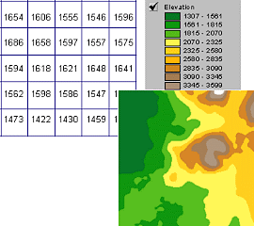
Raster data model
A grid defines geographic space as a matrix of identically-sized square cells. Each cell holds a numeric value that measures a geographic attribute (like elevation) for that unit of space.

Slide 31
The grid data structure
Grid size is defined by extent, spacing and no data value information
Number of rows, number of column
Cell sizes (X and Y)
Top, left , bottom and right coordinates
Grid values
Real (floating decimal point)
Integer (may have associated attribute table)

Slide 32
Definition of a Grid
Cell size
Number
of
rows
NODATA cell
(X,Y)
Number of Columns

Slide 33
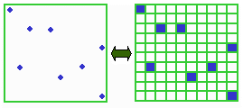
Points as Cells

Slide 34
Line as a Sequence of Cells

Slide 35
Polygon as a Zone of Cells

Slide 36
NODATA Cells

Slide 37
Cell Networks

Slide 38
Grid Zones

Slide 39
Floating Point Grids
Continuous data surfaces using floating point or decimal numbers

Slide 40
Value attribute table for categorical (integer) grid data
Attributes of grid zones

Slide 41
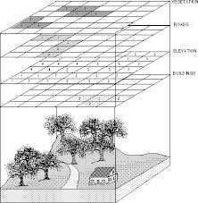
Raster data model with layers

Slide 42
Difference between Vector & Raster Data
Raster data model
location is referenced by a grid of cells in a rectangular array (matrix)
attribute is represented as a single value for that cell
much data comes in this form
images from remote sensing (LANDSAT, SPOT)
scanned maps
elevation data from USGS
best for continuous features:
elevation
temperature
soil type
land use
Vector data model
location referenced by x,y coordinates, which can be linked to form lines and polygons
attributes referenced through unique ID number to tables
much data comes in this form
census data (tabular)
best for features with discrete boundaries
property lines
political boundaries
transportation

Slide 43
Geospatial Access Control Models
Geospatial Data Authorization Model (image)
Geospatial Role Based Access Control Model
Location Based Access Control Model
Geospatial Web Access Control

Slide 44
Geospatial Data Authorization Model (Image)
In Geospatial web service, information that are presented on images (maps) are delivered to the users with the help of web technology and other image processing Applications.
This model presents an authorization process that allows the right image information after processing goes to the right hand.

Slide 45
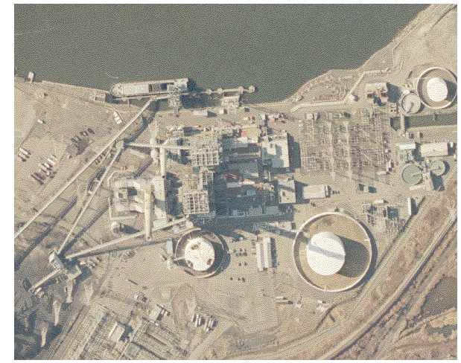
Geospatial Data Authorization Model (Image)

Slide 46
Geospatial Data Authorization Model (Image)
Geo-temporal policy that governs the access rights of the geospatial subjects to the geospatial objects.
Geospatial Role defined as per the Geo-temporal policy.
Geospatial Subject
Geospatial Object
Geospatial Permission
Evaluation

Slide 47
Geospatial Data Authorization Model
Spatio-temporal policies(image):
P1: All users(Subjects) can view 10 meter or lower resolution images (Objects).
P2: 1 meter resolution images of the parcel located in ”120 James Street, Newark, New Jersey” can be accessed only by the current owner of this parcel.
P3: Only military personnel positioned in Afghanistan can zoom-in to 1 meter resolution images over Afghanistan captured after September 11, 2001.
P4: The police officers positioned in Bergen County are allowed to access 1 meter resolution images of the nuclear power plant located at [-81.37227, 28.54623].

Slide 48
Geospatial Data Authorization Model
Security and privacy policy specifications:
Geographic coverage (area or extent)
Thematic content within the area
Zoom level of a particular location
Temporal nature of the objects.
Location of the requester/ his role within the area etc.
Notes:
* If any of these issues caused a schedule delay or need to be discussed further, include details in next slide.

Slide 49
Geospatial Data Authorization Model
Geotemporal Role:
Are used to specify a set of subjects possessing credentials having spatial and temporal properties indicating that each role is associated with a certain region and temporal interval.
Role changes depending on the user’s location and time.
Roles are assigned to users depending on the context a user is in.
A role “doctor” in Dhaka is different from a role “doctor” in Khulna.
A role ‘doctor’ in morning shift is different from a role of ‘doctor’ in the evening shift.

Slide 50
Geospatial Data Authorization Model
Geotemporal Role:
Geospatial role expression re = (r, sc)
Where r=traditional role as specified in RBAC
Sc = a scene that is associated with geospatial and temporal extents.
Each sc can be organized as a hierarchy in its own domain
Incident domain may have scene like fire, flood, earthquake etc.
Shopping domain may have scene like mall, retail shop, wholesale area, market etc.

Slide 51
Geospatial Data Authorization Model
Geotemporal Role:
Geospatial role expression re = (r, sc)
Each sc can be instantiated with a scene expression such as
Sc = {label, lt, lg, h,w, [t_{b}, t_{e}]}
where label is a descriptive scene name, such as ”Dhaka City”, ”mall” or ”fire,” and
{lt, lg, h,w} denotes latitude, longitude, height and width of a bounding box covering a geographic area of the scene and
[t_{b},t_{e}] denotes the temporal period of the scene.

Slide 52
Geospatial Data Authorization Model
Geotemporal Role(Example):
{“Police Officer”, “Dhaka City”} denotes any Police Officer at any place inside Dhaka City,
{“Police Officer”, “Motijheel PS”} denotes any Police Officer whose location is at Motijheel Police Station Area.
{“Police Officer”, “Motijheel PS”, “Morning Shift”} denotes any Police Officer whose location is at Motijheel Police Station Area and who is allowed to perform duties in the morning shift.

Slide 53
Geospatial Data Authorization Model
Geotemporal Object:
Each geotemporal object belongs to an object type.
Attributes of object types:
Unique identifier
Type of geospatial object
Longitude
Latitude
Height
Width
Resolution
Timestamp
Thematic link to the data set associated with the object
A geotemporal object is specified with a geotemporal object expression ge that is a logical expression of object attributes and their values.
ge={305,River, 30.80, 70.30, 200 m, …..}

Slide 54
Geospatial Data Authorization Model
Geotemporal Object:
Each geotemporal object belongs to an object type, which can be organized into a object type hierarchy.

Slide 55
Geospatial Data Authorization Model
Geotemporal permissions:
Viewing
Copying
Maintenance mode

Slide 56
Geospatial Data Authorization Model
Geotemporal permissions: Viewing
zoom-in allows a user to view an image covering a certain geographic area at a specific higher resolution level,
overlay allows users to generate composite images from multiple images ,
animate allows a user to obtain a time series of images and integrate them to show the changes in the images, and
fly-by allows a user to traverse from one location to another a multi-resolution browsing from low resolution images to high resolution images, or vice versa.

Slide 57
Geospatial Data Authorization Model
Geotemporal permissions: Copying
The copying modes, download and download-data, allow source files to be downloaded.
Viewing and copying are distinguished as separate privileges with geospatial data.

Slide 58
Geospatial Data Authorization Model
Geotemporal permissions: Maintenance mode
The maintenance modes include insert, delete, update and compose.
The users with compose privilege can create and insert value-added images, using images in the database.

Slide 59
Geospatial Data Authorization Model
Geotemporal Authorization (Policy)
An authorization is represented as a
Authorization = {re, ge, privilege, period, sign}
How a set of subjects represented by the role expression (re) has an access privilege to an object or a set of objects represented by geotemporal expression (ge) during the period.
The sign indicates allow or deny the privilege.

Slide 60
Geospatial Data Authorization Model
Geotemporal Authorization: Example
Authorization = {re, ge, privilege, period, sign}
re = {“Police Officer1”,Sc}, Sc={“Raman PS”, its location, morning shift}
re = {“Police Officer1”, “Ramna PS”, its location, morning shift}
ge = {“Ramna PS”, its location, Resolution, Timestamp, Road network}

Slide 61
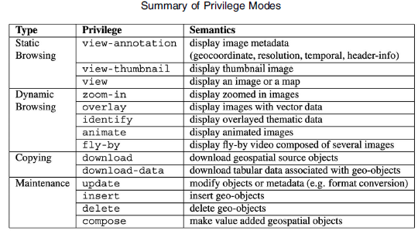

Slide 62
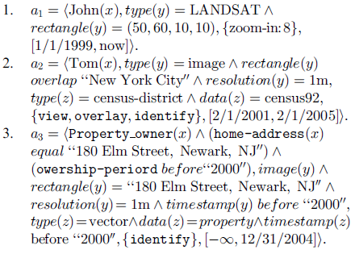
Example of authorization

Slide 63
These authorizations can be interpreted as follows:
a1: specifies that John is allowed to access a region centered at point (50,60) with width and height of 10 in LANDSAT images, with a zoom-in level of up to 8, during 1 January 1999 and now.

Slide 64
Geospatial Data Authorization Model
Access Control Evaluation: Access Request
Access request, r = {gtc, gto, p}
where gtc is a geotemporal credential expression of the user with the contextual information such as the current location and time the user is situated in,
gto is a geotemporal object expression that can include a particular image type, a spatial area with certain temporal footprint, and
p is a permission type.

Slide 65
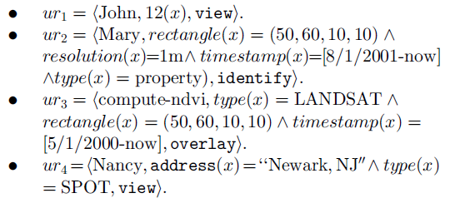
ur1 states that John wants to view objects with identifier equal to 12.
In ur2, Mary requests to identify the property information of a specific rectangular region represented by (50,60,10,10) from images of 1 meter resolution downloaded between 1 August 2001 and now.

Slide 66
Geospatial Data Authorization Model
Access Control Evaluation: processing evaluation
Authorization Policy = {re, ge, privilege, period, sign}
Access request, r = {gtc, gto, p}
gtc is matched with re in the policy statement, and when the spatial and temporal extents are included in the geotemporal role extents, the role is activated.
Then gto is matched with the authorized geotemporal expression ge in the policy.
The matching operations between the requested and policy geotemporal extents include predicates to check the spatial and temporal relationships such as containment, total and partial overlap, meet, and no-overlap.

Slide 67
Geospatial Data Authorization Model
Access Control Evaluation: processing evaluation
Authorization Policy = {re, ge, privilege, period, sign}
Access request, r = {gtc, gto, p}
When the geotemporal extent gto is contained, totally or partially overlapping with the object’s geotemporal extents ge in the authorization, and the requested permission matches with the one in the authorization, the authorization is allowed.
In case of partial overlap, only the overlapping area of the object should be delivered, which requires post-processing of the retrieved objects, such as cropping of images and mosaicking of multiple cropped objects.

Slide 68
Geospatial Role Based Access Control (RBAC) Model: Introduction
RBAC is centered on the notion of role.
A role is a semantic construct which represents a job function within an organization.
RBAC standards consists of four basic set of elements:
User: a human being or autonomous agent.
Role: represents a function of a user within a community.
Permission: an approval to perform an operation on one or more objects.
Session: When an user logs in, a session is established during which the user activates some subsets of role that s/he is assigned.

Slide 69
Geospatial Role Based Access Control (RBAC) Model: Example
Some data in the Geospatial Database needs protection:
Fish count update in the river.
Pollution index update in an area.
Patient information update in a hospital.
Some people are fixed for these responsibilities. So Role based access control works well in such situation.

Slide 70
Geospatial Role Based Access Control (RBAC) Model : Example
A mobile Application for the personnel and patient of a health care organization:
Individuals are given a location aware terminal with which they can request information service provided by an Application Server.
Functional roles of individuals:
Doctor, Nurse, Patient, General Staff etc.
Available services of users depends on their functional role.
Availability of roles and thus services depends on the location of the user.

Slide 71
Geospatial Role Based Access Control (RBAC) Model : Example
A mobile Application for the personnel and patient of a health care organization:
A doctor may be allowed to request the record of a patient only in the department she has been assigned to.
A doctor is also a member of the personnel of the organization and as such can be authorized to access additional services when located within the boundaries of the hospital.
Here the users of the Application of the hospital have different roles that are location dependent.

Slide 72
Geospatial Role Based Access Control (RBAC) Model
Role Based Access Control (RBAC)
Access decisions are based on the roles that individual user have as part of an organization’s policy.
Roles are closely related to the concept of user groups in the access control.
Role brings together a set of users on one side and a set of permissions on the other whereas user groups typically defined as a set of users.

Slide 73
Geospatial Role Based Access Control (RBAC) Model
Under Geo-RBAC, location aware applications analyzes the map vector data and user’s positions information to protect the information resources.
Access policies under this model may include:
P1: Only the environmental scientists currently making observations in the river within the Padma River area can enter the observed fish counts into the database.
P2: A surveyor working on a street in Bhutergoli can change the data on the illegal waste deposits in the region where he is located.
P3: A Doctor in Dhaka Medical Hospital wants to change the medicine of a patient in his/her cabin in the hospital.

Slide 74
Geospatial Role Based Access Control (RBAC) Model
Spatially aware Object
An object on the Earth is represented by a geometric shape(a point, a line or a polygon).
Each geometric object is tied to the Earth coordinates.
A point describes a single location, a line represents an ordered sequence of points, and a polygon is an ordered sequence of closed lines.
Minimum Bounding Box (MBB): set of all geometrics contained in a reference space.

Slide 75
Geospatial Role Based Access Control (RBAC) Model
Spatially aware Object
Objects to be protected consists of data about entities of the real world that may occupy a position.
These entities are called features that represent the spatial and non-spatial attributes.
Spatial features have name and location, i.e. geometry, while non-spatial features are not associated with any location.
Example of feature: Buriganga River, Bhutergoli, Shahin School etc. associated with a polygon or point geometry.
The features can have feature types such as River, Park, School, Road, Town, Lake, Car.

Slide 76
Geospatial Role Based Access Control (RBAC) Model
Spatially aware Object
Non-spatial attributes are not directly related to geometry to a particular Object, rather it can be spread over several Objects.
Example: fish count, vegetation index, crop production, pollution index etc.
These are expressed in thematic layers on the objects.

Slide 77
Geospatial Role Based Access Control (RBAC) Model
Spatial Role:
is defined as a pair (r, e)
where r is a role name and
e is the spatial extent determined by the boundaries of the space in which the role can be assumed by the user.
Example: A role surveyor can be associated to different extents, resulting in different spatial roles,
(surveyor, Khulna City) and (surveyor, Rangpur City) are two spatial roles.

Slide 78
Geospatial Role Based Access Control (RBAC) Model
Positional Model:
The actual user position that can change in time is modeled with either
a real position, that is actual geometry such as a point or a polygon, and/or
a logical position, i.e. spatial feature (such as city, Hospital, University campus etc.).
There is a one-to-many mapping function that can map the real position to logical positions.

Slide 79
Geospatial Role Based Access Control (RBAC) Model
Positional Model:
Real positions can be located on the satellite map using GPS.
Logical positions can be represented at different granularities depending on the spatial role played by the user.
Information with high resolution image may be allowed for privacy protection.
Why logical positioning is so important?

Slide 80
Geospatial Role Based Access Control (RBAC) Model
Geo-RBAC Model:
The spatially aware role based access control model consists of :
role schema and role instance,
permissions, users, and sessions.

Slide 81
Geospatial Role Based Access Control (RBAC) Model: Spatial role
Role Schema: R_{S} = {r, ext, loc, m_{loc}}
It defines
r = a common name for a set of spatial roles,
ext = a feature type of role extent (spatial constraints) where roles can be enabled,
loc = a feature of logical position for the users who may assume the role and
Mapping function to calculate logical position.

Slide 82
Geospatial Role Based Access Control (RBAC) Model: Spatial role
Role Schema: R_{S} = {r, ext, loc, m_{loc}}
Example: R_{S} = {Doctor, Hospital, Sector, m_{Sector}}
Doctor is the common name for a set of spatial roles,
Hospital is the feature type of the role extent
Sector is the feature type of logical position (Hospital area is divided in sectors: Cabin, OT, Ward, Department etc.)
m_{Section} is the position mapping function.

Slide 83
Geospatial Role Based Access Control (RBAC) Model: Spatial role
Role Schema: R_{S} = {r, ext, loc, m_{loc}}
The Role Schema for a role name, say “Doctor” is unique.
For Example:
{Doctor, Hospital, Sector, m_{Sector}} and
{Doctor, Department, Room, m_{Room}} are not allowed.

Slide 84
Geospatial Role Based Access Control (RBAC) Model: Spatial role
A role instance is a role fulfilling the constraints defined in the role schema.
Given a role schema, a role instance, r_{i} = {r, e} is created when the role extent is assigned with a particular feature.
For instance, a role instance could be a Doctor inside OT of PG Hospital.
R_{S} : {Doctor, Hospital, Sector, m_{Sector}}
R_{I} : {Doctor, PG Hospital, OT}
R_{II} : {Doctor, PG Hospital, Cabin}
R_{III} : {Doctor, PG Hospital, Chamber}

Slide 85
Geospatial Role Based Access Control (RBAC) Model : Permission
These are operations performed on spatial objects such as getPatientInfo over a hospital feature, getTrafficInfo over a road feature.
It can be associated either with the role schema and inherited by all role instances of the schema or directly with role instances.
Given a set of operations(OPS) and a set of objects(OBJ), permissions are represented as a pair{operation, object}.

Slide 86
Geospatial Role Based Access Control (RBAC) Model : Sessions
When a user logs in, a new session is activated and a number of roles are selected to be included in the session role set.
For a session role to be enabled, the user must be logically located within the space of the role extent.
Suppose a Doctor has logged into the Application. Following roles may be activated:
Doctor in the patient management Application
User of laundry service Application
Leave Applications.

Slide 87
Geospatial Role Based Access Control (RBAC) Model: Access Control
The access control is specified as a set of assignment relations between permissions to spatial roles, between users and spatial roles:
Users-to-Spatial Role Assignment:
It relates users to roles through a many-to-many relationship.
A user can be assigned multiple roles and the same roles can be assigned to different users.
Users |  | Spatial Roles
Dr. Kamal |  | Doctor, OT
Dr. Jamal |  | Doctor, Cabin
Dr. Kabir |  | Doctor, Outdoor

Slide 88
Geospatial Role Based Access Control (RBAC) Model: Access Control
Permission to Spatial role assignments: The mappings can be specified between the permission to spatial role schema and between spatial role instances to permissions.
A Role can be assigned multiple permissions and each permission can be assigned to multiple Roles.
Permissions |  | Spatial Roles
View info |  | Doctor
Update info |  | Nurse
Delete info |  | Pathologist

Slide 89
Geospatial Role Based Access Control (RBAC) Model: Access Request Evaluation
Access request ={s, rp, p, o}
s = user of session
rp = User’s real position
p = User wants to perform operation on object o.

Slide 90
Geospatial Role Based Access Control (RBAC) Model: Access Request Evaluation
Access Request ={s, rp, p, o}
A user logs in and a session ID is generated and a number of roles will be enabled to be included in the session role set under session ID based on the user’s position.
Logical location of the user is computed using user’s real position and the location mapping function in the role schema, R_{S} = {r,ext,loc, m_{loc}}
If the logical location is within the role extent, the role is enabled.

Slide 91
Geospatial Role Based Access Control (RBAC) Model: Access Request Evaluation
Access Request ={s, rp, p, o}
For each enabled role, the set of permissions assigned to the corresponding role schema is determined.
If the requested permission (p,o) is matched with the permission assignment rules for an enabled role, then the access request is granted.

Slide 92
Geospatial Role Based Access Control (RBAC) Model: Example-Access Request Evaluation:
Access request ={s, rp, p, o}
rp = Inside the map of PG Hospital (inside OT) identified by GPS.
(p,o) = Update patient’s records.
R_{S} : {Doctor, Hospital, Sector, m_{Sector}} is activated or
R_{I} : {Doctor, PG Hospital, OT} is activated.
R_{S} / R_{I} are assigned to session ID of the user after evaluating the containment between user’s logical position and role extent.
For each enabled role, the set of permissions assigned to the corresponding role schema is determined.
If there are such permission assignment rules for an enabled role, then the access request is granted.

Slide 93
Location Based Access Control (LBAC)
For secure access to data by mobile users, following points are considered to identify the roles allowed/denied:
Physical and dynamic location of the requester
Credential of the requester

Slide 94
Location Based Access Control (LBAC)
The context data about location and timing are made available by third parties (e.g. mobile phone operators) through service interfaces called Location Services .
However, the mobile network technology does not provide an exact location measure, which a Location Service performs, and has a degree of uncertainty due to technological limitations and possible environmental effects.

Slide 95
Difference between RBAC and LBAC
In RBAC, user’s static location is considered to determine allow/deny of access whereas in LBAC, users dynamic location is considered.
As a result, RBAC is suitable for static environment (Hospital, Road, River etc.) whereas LBAC is suitable for dynamic environment (war, earthquake, cyclone etc.).
RBAC considers logical location on the map vector data for granting or denying access whereas LBAC considers only physical location.
RBAC does not take the external help while taking the access decision where LBAC takes help of external service provider (Telco for location based service).

Slide 96
Examples of LBAC Policy
P1: System administrators are authorized to configure the mobile network if they are in the server farm room, they are alone in such an area, and move at walking speed at most.
P2: The CEO is authorized to access mobile network statistics if there is nobody close by and she is not in a competitor location.
P3: Guests can read mobile network statistics if there is nobody close by and they are in a corporate location.

Slide 97
LBAC: Subject, Object & Action
Subject:
represented with subject expression, which is a Boolean conditional predicate to refer to a set of subjects depending on whether they satisfy certain conditions.
The conditions are evaluated with
the user’s profile,
location, and
the user’s membership in groups or active roles.
Example:–
subject: equal(job,Professor) ^ greater than(age,35 )

Slide 98
LBAC: Subject, Object & Action
Object:
represented with a Boolean object expression, which refers to a set of objects that satisfy the conditions in the object expression where conditions evaluate membership of the object in categories, and values of properties on metadata.
object: equal(level,critical ) ^ less than(creation,2008/01/01 )
Action:
is the action (or class of actions) that is allowed or denied.
actions: read

Slide 99
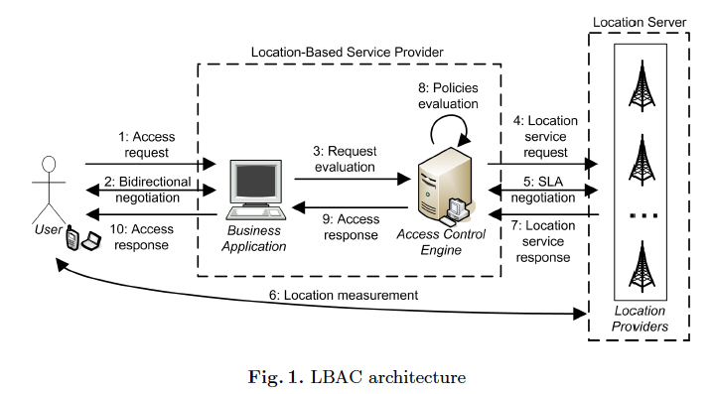
LBAC: Architecture
Interactions among the four entities are carried out via request response message.
Notes:
User: The entity whose access request to a location server must be authorized by a LBAC system. Users carry terminals enabling authentication and some form of location verification.
Business application: Customer-oriented application that offers services whose release is regulated by location-based policies.
Access Control Engine (ACE): The entity that is responsible for evaluating access requests according to some location-based policies. The ACE communicates with one or more Location Providers for acquiring location information. The ACE does not have direct access to the location information; rather, it sends requests to external services and waits for the corresponding answers.
Location Providers (LPs): The trusted entities that provide the location information (e.g., context data about location and timing, location-based predicate evaluation) by implementing Location Server
interfaces.

Slide 100
LBAC: Architecture
Step 1: User submits an access request to Business Application
Notes:
User: The entity whose access request to a location server must be authorized by a LBAC system. Users carry terminals enabling authentication and some form of location verification.
Business application: Customer-oriented application that offers services whose release is regulated by location-based policies.
Access Control Engine (ACE): The entity that is responsible for evaluating access requests according to some location-based policies. The ACE communicates with one or more Location Providers for acquiring location information. The ACE does not have direct access to the location information; rather, it sends requests to external services and waits for the corresponding answers.
Location Providers (LPs): The trusted entities that provide the location information (e.g., context data about location and timing, location-based predicate evaluation) by implementing Location Server
interfaces.

Slide 101
LBAC: Architecture
Step 2: Negotiation to exchange those data relevant to the policy evaluation.
Notes:
User: The entity whose access request to a location server must be authorized by a LBAC system. Users carry terminals enabling authentication and some form of location verification.
Business application: Customer-oriented application that offers services whose release is regulated by location-based policies.
Access Control Engine (ACE): The entity that is responsible for evaluating access requests according to some location-based policies. The ACE communicates with one or more Location Providers for acquiring location information. The ACE does not have direct access to the location information; rather, it sends requests to external services and waits for the corresponding answers.
Location Providers (LPs): The trusted entities that provide the location information (e.g., context data about location and timing, location-based predicate evaluation) by implementing Location Server
interfaces.

Slide 102
LBAC: Architecture
Step 3: Request sent to ACE that interacts with LBS (step 4 – 7)
Notes:
User: The entity whose access request to a location server must be authorized by a LBAC system. Users carry terminals enabling authentication and some form of location verification.
Business application: Customer-oriented application that offers services whose release is regulated by location-based policies.
Access Control Engine (ACE): The entity that is responsible for evaluating access requests according to some location-based policies. The ACE communicates with one or more Location Providers for acquiring location information. The ACE does not have direct access to the location information; rather, it sends requests to external services and waits for the corresponding answers.
Location Providers (LPs): The trusted entities that provide the location information (e.g., context data about location and timing, location-based predicate evaluation) by implementing Location Server
interfaces.

Slide 103
LBAC: Architecture
Step 8: evaluates policies
Step 9 - 10: returns an access decision.
Notes:
User: The entity whose access request to a location server must be authorized by a LBAC system. Users carry terminals enabling authentication and some form of location verification.
Business application: Customer-oriented application that offers services whose release is regulated by location-based policies.
Access Control Engine (ACE): The entity that is responsible for evaluating access requests according to some location-based policies. The ACE communicates with one or more Location Providers for acquiring location information. The ACE does not have direct access to the location information; rather, it sends requests to external services and waits for the corresponding answers.
Location Providers (LPs): The trusted entities that provide the location information (e.g., context data about location and timing, location-based predicate evaluation) by implementing Location Server
interfaces.

Slide 104
LBAC: Architecture
Communication between ACE and LSP may be driven by a SLA negotiation phase (step 5).
This negotiation is used to agree upon and set quality of services attributes and the corresponding cost.
Notes:
User: The entity whose access request to a location server must be authorized by a LBAC system. Users carry terminals enabling authentication and some form of location verification.
Business application: Customer-oriented application that offers services whose release is regulated by location-based policies.
Access Control Engine (ACE): The entity that is responsible for evaluating access requests according to some location-based policies. The ACE communicates with one or more Location Providers for acquiring location information. The ACE does not have direct access to the location information; rather, it sends requests to external services and waits for the corresponding answers.
Location Providers (LPs): The trusted entities that provide the location information (e.g., context data about location and timing, location-based predicate evaluation) by implementing Location Server
interfaces.

Slide 105
LBAC: Location-based Predicates
Position-based conditions
Movement based conditions
Interaction-based conditions

Slide 106
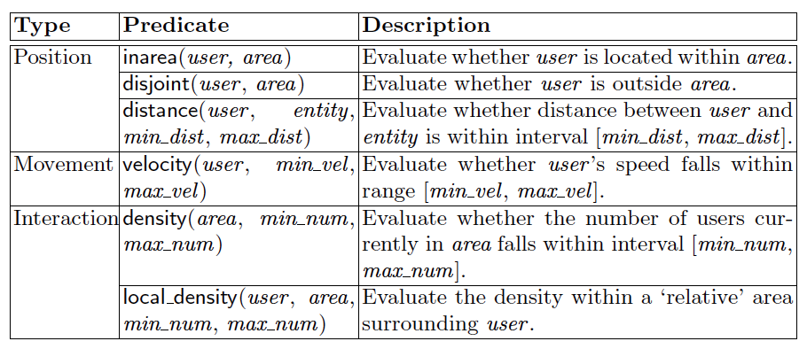
LBAC: Location-based Predicates

Slide 107
LBAC: Location-based Predicates
Verification of these predicates depends on the accuracy of the location technology.
It requires Service Level Agreement (SLA).
Locational predicates are evaluated to either true or false with the confidence value and timeout.
Example:
inarea(Kamal, “Ramna Park”) = {True, 0.9,”14/04/2016 11:30am”}

Slide 108
LBAC: Models of Policy Rules
Access control rule = {subj_expr, obj_expr, action} where
subj-expr refers to the conditional expression for subjects, whereas conditions can evaluate the user’s profile/properties or the user’s membership in a group, active roles, and so on.
obj-expr refers to the conditional expression for objects, where conditions evaluate membership of the object in categories value of metadata and so on, and
action refers to a privilege mode.

Slide 109
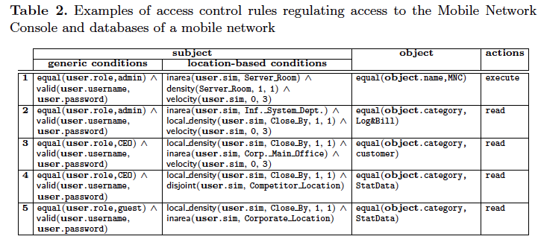
LBAC: Models of Policy Rules

Slide 110
LBAC Policy Evaluation and Enforcement
Access request = {user id, SIM, action, object id},
Example:
AR = {2345, 90900000, read, 67890}
Rule: any citizen age greater than 55 years from inside Bangladesh can read a particular doc.
Doc ID

Slide 111
LBAC Policy Evaluation and Enforcement
Access request = {user id, SIM, action, object id}
Access control Policy= {subj expr, obj expr, action}
First, Access Control Engine evaluates policy P collecting all the rules A in P that are applicable to the request.
The set A of applicable rules contains those rules r ∈ P for which action(r) corresponds to the action specified in the access request, and object id satisfies the conditions specified in obj-expr(r) .

Slide 112
LBAC: Architecture
Interactions among the four entities are carried out via request response message.
Notes:
User: The entity whose access request to a location server must be authorized by a LBAC system. Users carry terminals enabling authentication and some form of location verification.
Business application: Customer-oriented application that offers services whose release is regulated by location-based policies.
Access Control Engine (ACE): The entity that is responsible for evaluating access requests according to some location-based policies. The ACE communicates with one or more Location Providers for acquiring location information. The ACE does not have direct access to the location information; rather, it sends requests to external services and waits for the corresponding answers.
Location Providers (LPs): The trusted entities that provide the location information (e.g., context data about location and timing, location-based predicate evaluation) by implementing Location Server
interfaces.

Slide 113
LBAC Policy Evaluation and Enforcement
For evaluation, Access Control Engine submits the query to the Location Service Provider for response.
LSP returns the results in the form of Boolean value, confidence, timeout .
Given the response, ACE determines whether or not the value returned by the Location Service can be considered valid for the purpose of controlling access.
Such an evaluation depends on parameters timeout and confidence returned by LSP.

Slide 114
LBAC Policy Evaluation and Enforcement
For responses with expired timeout, it automatically triggers the re-evaluation of the predicate regardless of the other parameter values.
For unexpired responses, the engine evaluates the responses with respect to the confidence value.
The evaluation maintains the extended truth table that maintains the acceptable confidence level for each predicate with minimum and maximum thresholds.

Slide 115
LBAC Policy Evaluation and Enforcement
If the confidence level in response is greater than maximum threshold in the truth table, the returned value is confirmed.
If the confidence level is less than the minimum threshold, then the returned value is evaluated to false.
If the returned confidence level falls between the maximum and minimum thresholds, the engine submits the re-evaluation query to LSP, since it is not clear if the returned results are reliable enough.
The truth table for each predicate also maintains the maximum retry for the evaluation.

Slide 116
LBAC Policy Evaluation and Enforcement
Example: An user sends a request = {user id, SIM, action, object id}
ACE send a request to LSP = inarea{Kamal, GPDC, Dhaka},
LSP response = [True 0.85,2009-01-20,09:00pm]
Suppose that for inarea predicate the lower and upper thresholds are 0.2 and 0.8, respectively, and
that inarea(Kamal,GPDC) = [True 0.85,2009-01-20,09:00pm]
is the triple returned by the LP to the ACE stating that Alice is located in the Data Center of GP with confidence of 85%.
Such an assessment is to be considered valid until 9:00pm of January 20th, 2009.
The ACE evaluates inarea(Kamal,GPDC, Dhaka) to True, since 0.85>0.80

